Slide 1
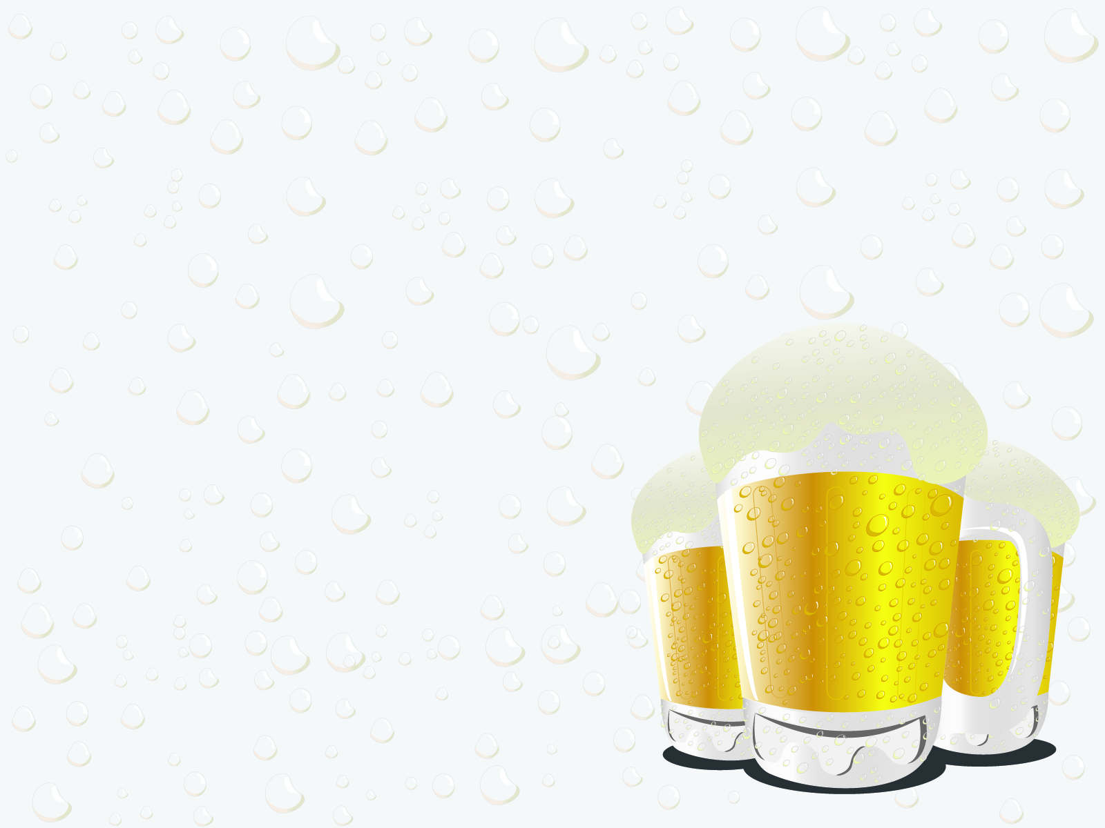
Beer O’Clock Company
Analysis of Competitor ABV & IBU
Content and Correlation between ABV & IBU
February 26, 2019
Shane Weinstock & Tom Gianelle Inc.

Slide 2

“Just because you can put a pound of hops into a beer, doesn’t mean you should.” Trademark Pending
Beer O’Clock is pursuing a product that goes against the current hoppy trend. The goal is to offer a product that has a higher alcohol content by volume (ABV) than the median of the current market, while being below the median IBU (or bitterness) level that comes from hops.
This is a study the of the ABV and the International Bitterness Units (IBU) contained in your competitors’ products.

Slide 3

Research
Goal
Our goal is to determine how the Beer O’Clock’s new product (high ABV and lower IBU) will compare with the competition’s products and if there is a correlation of ABV to IBU and ultimately discovering if that will have an impact on creating target product.
Beer O'Clock is planning to initially offer new beer in it’s base state of Texas, but they are also interested in selling the new product in other nearby states:
Arkansas
Louisiana
Oklahoma

Slide 4
First Step –
Data Analysis
The analysis was completed utilizing the provided brews.csv and breweries.csv files.
Below is sample of first 6 & last 6 combined data. In addition, the number of NA’s that were needed to be removed from study.
This helped us verify that we had the right data, but also that we needed to clean the data provided.
Missing Values Report
 | % of NA
# of NA | <dbl>
<dbl>
IBU | 1005 | 42
ABV | 62 | 3
Brewery_id | 0 | 0
Brewery Name | 0 | 0
City | 0 | 0
State | 0 | 0
Beer Name | 0 | 0
Beer_ID | 0 | 0
Style | 0 | 0
Ounces | 0 | 0
Return of First Six Lines
ID | Brewery Name | City | State | Beer Name | BeerID | ABV | IBU | Style | Oz
1 | NorthGate Brewing | Minneapolis | MN | Pumpion | 2689 | 0.06 | 38 | Pumpkin Ale | 16
1 | NorthGate Brewing | Minneapolis | MN | Stronghold | 2688 | 0.06 | 25 | American Porter | 16
1 | NorthGate Brewing | Minneapolis | MN | Parapet ESB | 2687 | 0.056 | 47 | ESB | 16
1 | NorthGate Brewing | Minneapolis | MN | Get Together | 2692 | 0.045 | 50 | American IPA | 16
1 | NorthGate Brewing | Minneapolis | MN | Maggie's Leap | 2691 | 0.049 | 26 | Milk / Sweet Stout | 16
1 | NorthGate Brewing | Minneapolis | MN | Wall's End | 2690 | 0.048 | 19 | English Brown Ale | 16
Return of Last Six Lines
ID | Brewery Name | City | State | Beer Name | BeerID | ABV | IBU | Style | Oz
556 | Ukiah Brewing Company | Ukiah | CA | Pilsner Ukiah | 98 | 0.055 | NA | German Pilsener | 12
557 | Butternuts Beer and Ale | Garrattsville | NY | Porkslap Pale Ale | 49 | 0.043 | NA | American Pale Ale (APA) | 12
557 | Butternuts Beer and Ale | Garrattsville | NY | Snapperhead IPA | 51 | 0.068 | NA | American IPA | 12
557 | Butternuts Beer and Ale | Garrattsville | NY | Moo Thunder Stout | 50 | 0.049 | NA | Milk / Sweet Stout | 12
557 | Butternuts Beer and Ale | Garrattsville | NY | Heinnieweisse Weissebier | 52 | 0.049 | NA | Hefeweizen | 12
558 | Sleeping Lady | Anchorage | AK | Urban Wilderness Pale Ale | 30 | 0.049 | NA | English Pale Ale | 12
Source: brews.csv & breweries.csv

Slide 5
Research Findings – Summary Statistics
Diving into this we wanted to run some basic analysis and find our benchmarks and possibly any initial correlations that we might be able to conclude:
Medians: ABV = 0.056 IBU = 35
Means: ABV = 0.059 IBU = 42.71
Max: ABV = 0.128 IBU = 138
SD: ABV = 0.013 IBU = 25.95
From this summary we can establish that we want a beer that will have a value of ABV between 0.056 and .128 and then IBU between 35 to 138.
To refine this goal, as our margins are rather large, we suggest the product target be greater than the mean by 2-3 standard deviations. This would set our values at: ABV [.069,.082] and IBU [20-25] is derived from company’s stated lower IBU goal.
Source: brews.csv
Appendix B contains the state level statistics analysis
Notes:
Observe the medians and the means are very close together and that the
Means and medians of the two variables are decently close, giving us little variation with some outliers also being observed.

Slide 6
Next Steps – Research Findings
We first wanted to gain an insight of our competition as we know what state we will begin our operation in. We drew a sample of current brewery and beer data to conclude the following.
State | Number of Breweries | Ranking
TX | 28 | 5
OK | 6 | 27
LA | 5 | 30
AR | 2 | 44
For the target markets, the table show the ranking by number of breweries and count of breweries by state. In Appendix A the entire list of states by number of breweries is shown.
Source: Appendix A breweries.csv

Slide 7
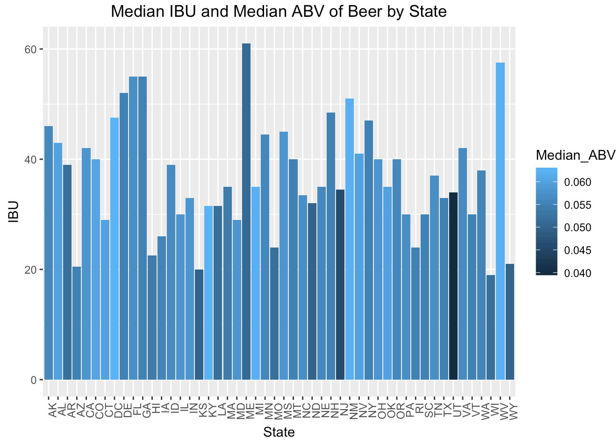
At first glance, no correlation between median ABV & median IBU.
In addition, we found it difficult to interpret the target state medians. Therefore we developed the following map graphs.
Source: brews.csv & breweries.csv

Slide 8
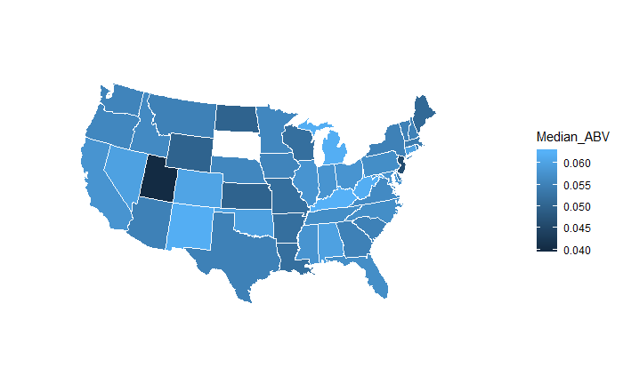
Analysis
ABV - Statewide Comparisons
As now we know there’s a correlation, we examined the states “Beer O'Clock” and wanted to introduce a product.
This map helps us better understand how the new product will stand out in the current markets.
In this chart for example, we can see that Texas has a generally higher than average median ABV. KS, AR and LA are even higher median ABV. Only OK has a lower than median ABV.
In target markets, the ABV planned in new product will be only slightly higher than the median ABV in beers produced by competitors.
Source: brews.csv
Notes:
Note that the variation between states is not very large.

Slide 9
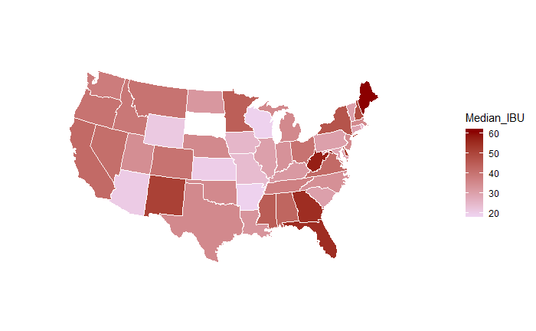
IBU - Statewide Comparisons
Analysis
As we continue our comparison to examine the IBU market, we can see that AR, OK. TX are are at the median IBU level. LA is slightly lower IBU and KS is very low.
There is additional analysis of target and potential comparison states in Appendix B.
Source: brews.csv
Notes:
Note that the variation between states is not very large.

Slide 10
Brewers & Beers with
Max IBU and ABV values
We wanted to examine the products and the locations of the max values for both variables we’d been observing.
MAX IBU: Astoria, OR produces the highest IBU at 138 as an American Double/Imperial IPA from Astoria Brewing Company with a beer named the "Bitter Bitch Imperial IPA".
MAX ABV: Boulder, CO produces the highest ABV at 12.8% from brewery Upslope Brewing Company for beer Lee Hill Series Vol. 5 - a Belgian Style Quadrupel Ale.

Slide 11
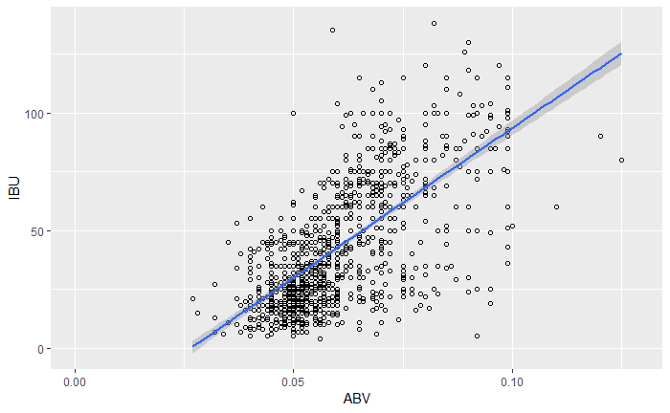
The ‘Hops’ Analysis
This correlation was first drawn as a scatterplot and then calculated with a Pearson R method.
We next examined if a correlation exists between IBU and ABV. This way we could understand if our bitterness derived from hops would influence the ABV.
After computing the variations of IBU and ABV, we observed a 67% relationship between the two variables. Allowing us to conclude that there is statistical significance to believe that a higher level of hops (or bittering agent) will also yield us a generally higher ABV.
Source: brews.csv & breweries.csv

Slide 12
Conclusion
Based on the data that is provided, we can conclude that:
Given the high (42%) of NA’s in the data, it is difficult to provide any certainty on the entire brews population. For the available data there did show a 67% correlation (using Pearson r) between ABV & IBU.
Matching a product that is highly produced in AR and KS could provide a unique product opportunity to the company’s other target markets (LA, OK, TX).

Slide 13
_{Appendix A}
State | Number of Breweries | Ranking
CO | 47 | 1
CA | 39 | 2
MI | 32 | 3
OR | 29 | 4
TX | 28 | 5
PA | 25 | 6
MA | 23 | 7
WA | 23 | 8
IN | 22 | 9
WI | 20 | 10
NC | 19 | 11
IL | 18 | 12
NY | 16 | 13
VA | 16 | 14
FL | 15 | 15
OH | 15 | 16
MN | 12 | 17
AZ | 11 | 18
VT | 10 | 19
ME | 9 | 20
MO | 9 | 21
MT | 9 | 22
CT | 8 | 23
AK | 7 | 24
GA | 7 | 25
MD | 7 | 26
OK | 6 | 27
IA | 5 | 28
ID | 5 | 29
LA | 5 | 30
NE | 5 | 31
RI | 5 | 32
HI | 4 | 33
KY | 4 | 34
NM | 4 | 35
SC | 4 | 36
UT | 4 | 37
WY | 4 | 38
AL | 3 | 39
KS | 3 | 40
NH | 3 | 41
NJ | 3 | 42
TN | 3 | 43
AR | 2 | 44
DE | 2 | 45
MS | 2 | 46
NV | 2 | 47
DC | 1 | 48
ND | 1 | 49
SD | 1 | 50
WV | 1 | 51
In this table we can observe the number of beers that are offered in each state established by the provided data. We have added a ranking column to assist in sorting the data in for a much more quick reference.
Source: brews.csv & breweries.csv

Slide 14
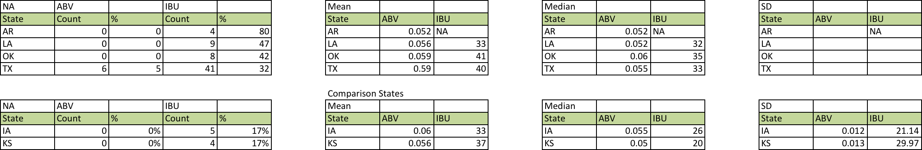
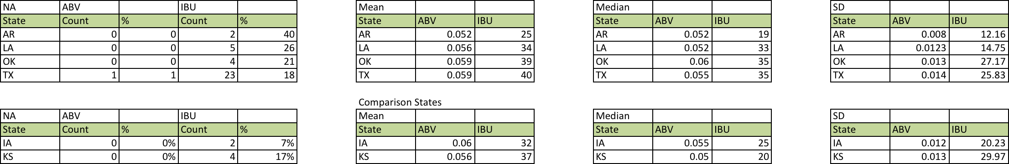
_{Appendix B}
_{Before Data Scrub:}
.
_{After Data Munging:}
45% IBU’s identified. All other missing data due to beer no longer being offered or brewer stopped selling beer
Note: In analysis, used median to negate influence from outliers
Source: brews.csv

